Slide 1
API
Application programming interface

Slide 2
API
Application Programming Interfaces (APIs) are constructs made available in programming languages to allow developers to create complex functionality more easily.
They abstract more complex code away from you, providing some easier syntax to use in its place.
Eg: As a real-world example, think about the electricity supply in your house, apartment, or other dwellings. If you want to use an appliance in your house, you plug it into a plug socket and it works. You don't try to wire it directly into the power supply — to do so would be really inefficient and, if you are not an electrician, difficult and dangerous to attempt.

Slide 3
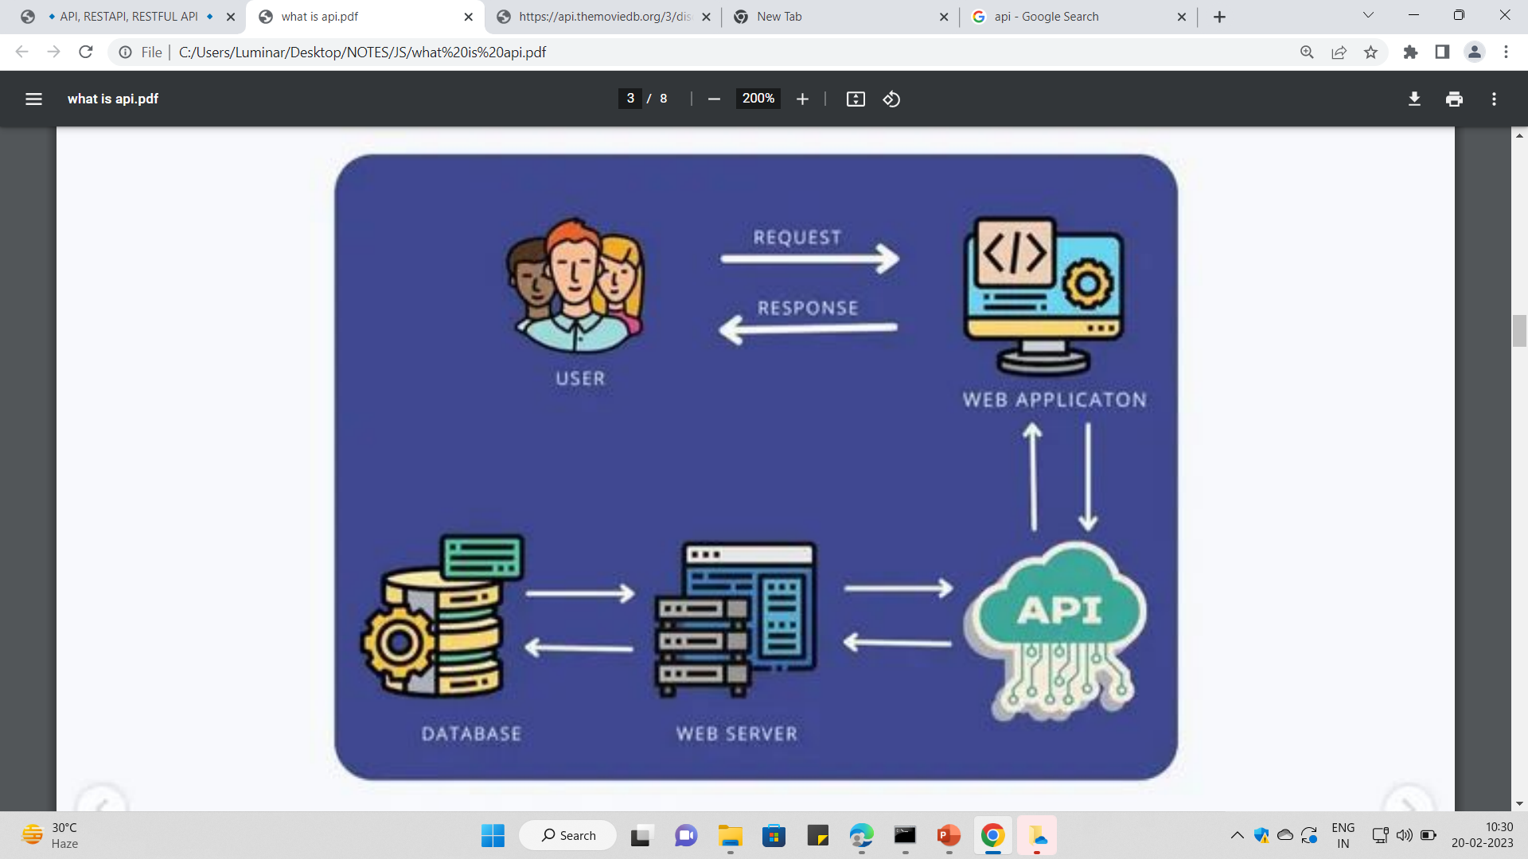

Slide 4
APIs in client-side JavaScript
Browser APIs are built into your web browser and are able to expose data from the browser and surrounding computer environment and do useful complex things with it.
For example, the Web Audio API provides JavaScript constructs for manipulating audio in the browser — taking an audio track, altering its volume, applying effects to it, etc. In the background, the browser is actually using some complex lower-level code (e.g. C++ or Rust) to do the actual audio processing. But again, this complexity is abstracted away from you by the API.

Slide 5
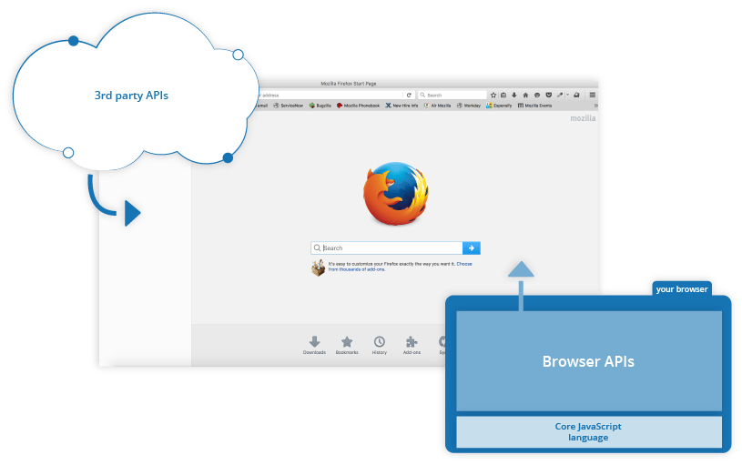
Third-party APIs are not built into the browser by default, and you generally have to retrieve their code and information from somewhere on the Web.
For example, the Twitter API allows you to do things like displaying your latest tweets on your website.
It provides a special set of constructs you can use to query the Twitter service and return specific information.

Slide 6
Relationship between JavaScript, APIs, and other JavaScript tools
client-side JavaScript APIs are, and how they relate to the JavaScript language
JavaScript — A high-level scripting language built into browsers that allows you to implement functionality on web pages/apps. Note that JavaScript is also available in other programming environments, such as Node.
Browser APIs — constructs built into the browser that sits on top of the JavaScript language and allows you to implement functionality more easily.
Third-party APIs — constructs built into third-party platforms (e.g. Twitter, Facebook) that allow you to use some of those platform's functionality in your own web pages (for example, display your latest Tweets on your web page).

Slide 7
JavaScript libraries — Usually one or more JavaScript files containing custom functions that you can attach to your web page to speed up or enable writing common functionality. Examples include jQuery, Mootools and React.
JavaScript frameworks — The next step up from libraries, JavaScript frameworks (e.g. Angular and Ember) tend to be packages of HTML, CSS, JavaScript, and other technologies that you install and then use to write an entire web application from scratch. The key difference between a library and a framework is "Inversion of Control". When calling a method from a library, the developer is in control. With a framework, the control is inverted: the framework calls the developer's code.

Slide 8
common categories of browser API
APIs for manipulating documents loaded into the browser.
APIs that fetch data from the server to update small sections of a webpage on their own are very commonly used
APIs for drawing and manipulating graphics are widely supported in browsers
Audio and Video APIs like HTMLMediaElement, the Web Audio API, and WebRTC
Device APIs enable you to interact with device hardware: for example, accessing the device GPS to find the user's position using the Geolocation API.
Client-side storage APIs enable you to store data on the client-side

Slide 9
Common third-party APIs
The Twitter API, which allows you to do things like displaying your latest tweets on your website.
Map APIs, like Mapquest and the Google Maps API, which allow you to do all sorts of things with maps on your web pages.
The Facebook suite of APIs, which enables you to use various parts of the Facebook ecosystem to benefit your app, such as by providing app login using Facebook login, accepting in-app payments, rolling out targeted ad campaigns, etc.
The YouTube API, which allows you to embed YouTube videos on your site, search YouTube, build playlists, and more.

Slide 10
Benefits Of Using API
APIs needed to make the connection between application functions to handle the data from predefined processes
Easy of Integration: APIs can be embedded with any type of software application, so it can be easily integrate with the applications and functions between different websites

Slide 11
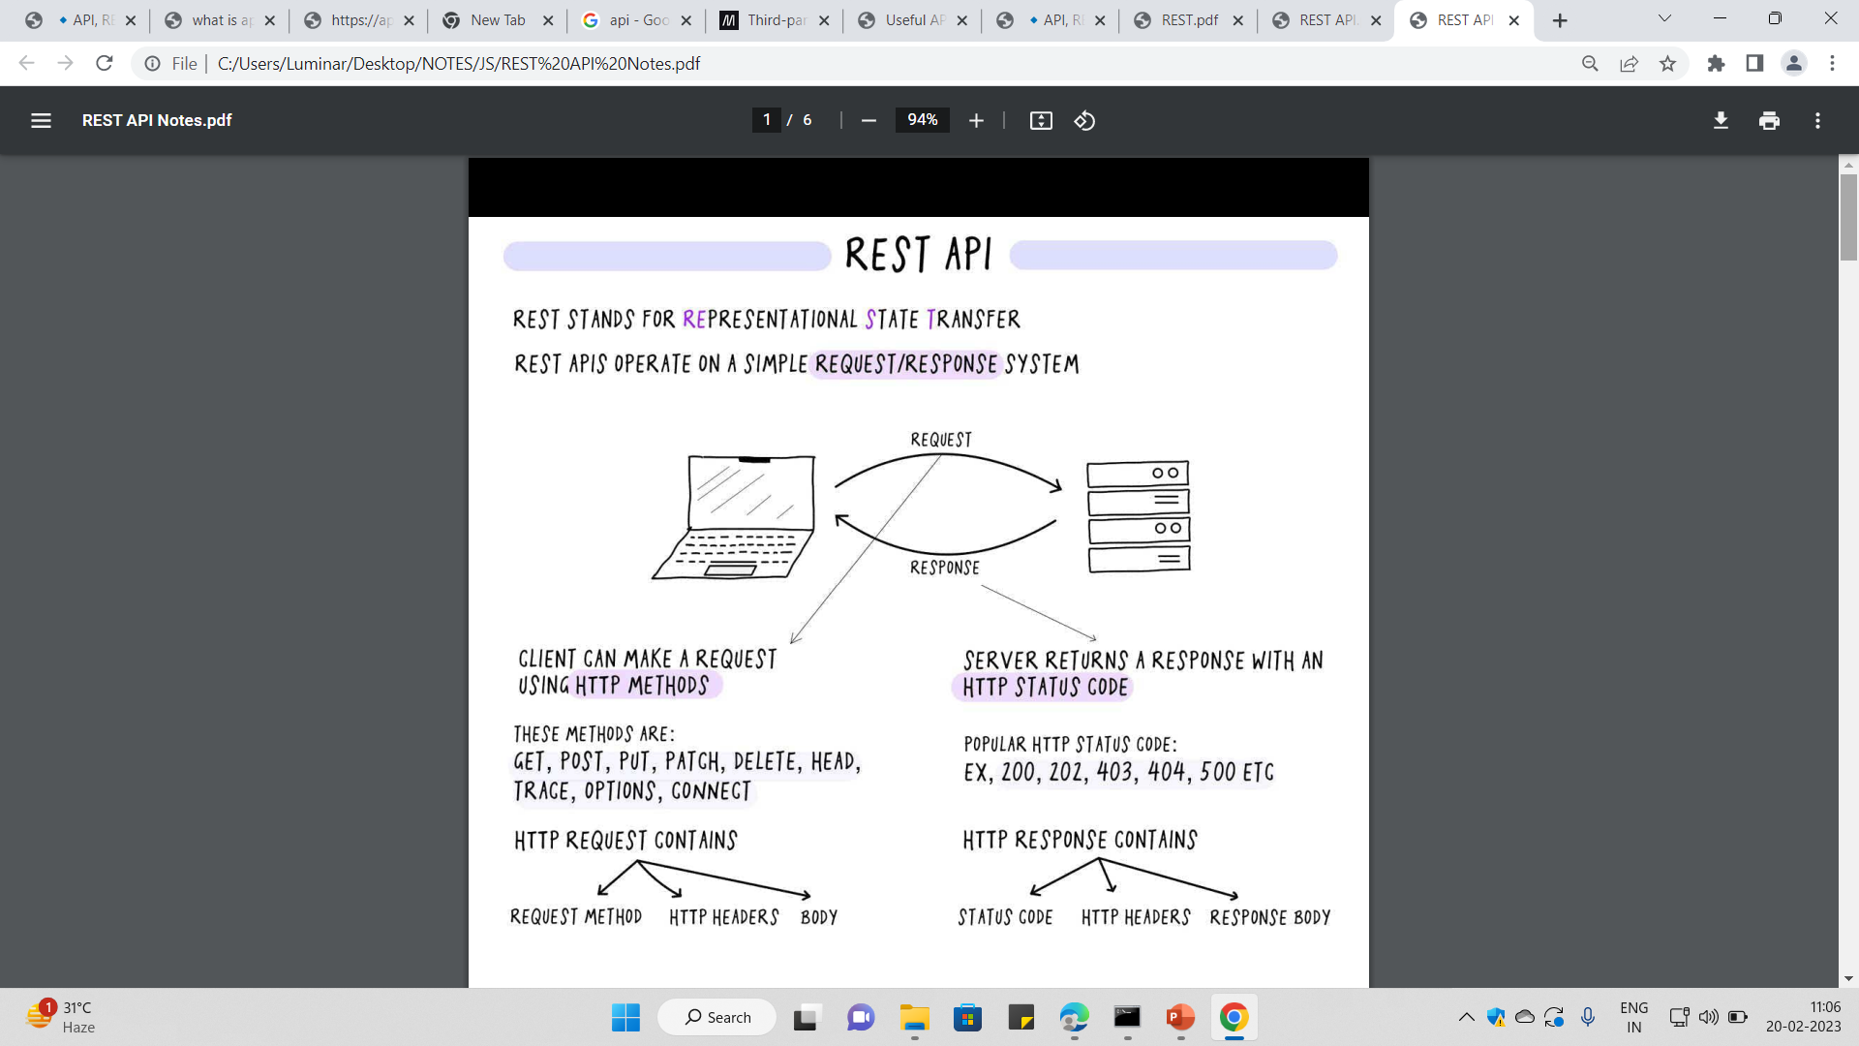

Slide 12
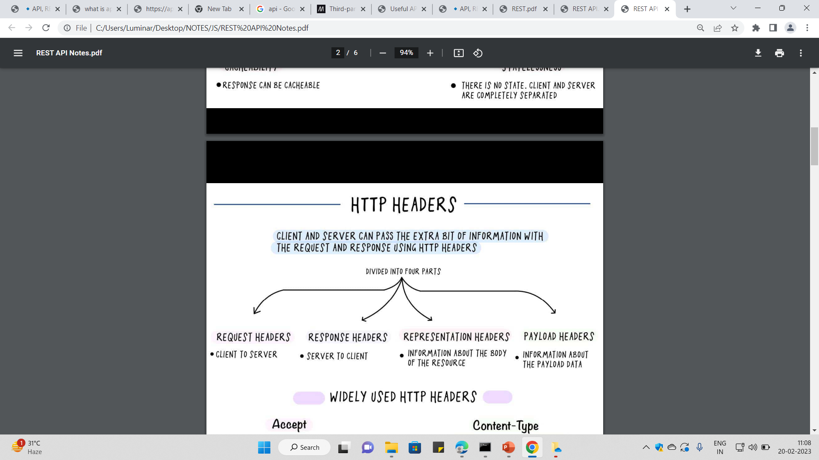

Slide 13
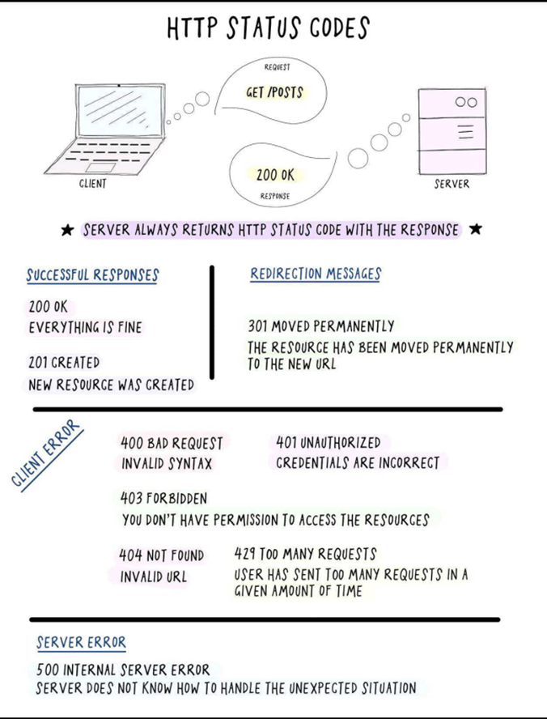
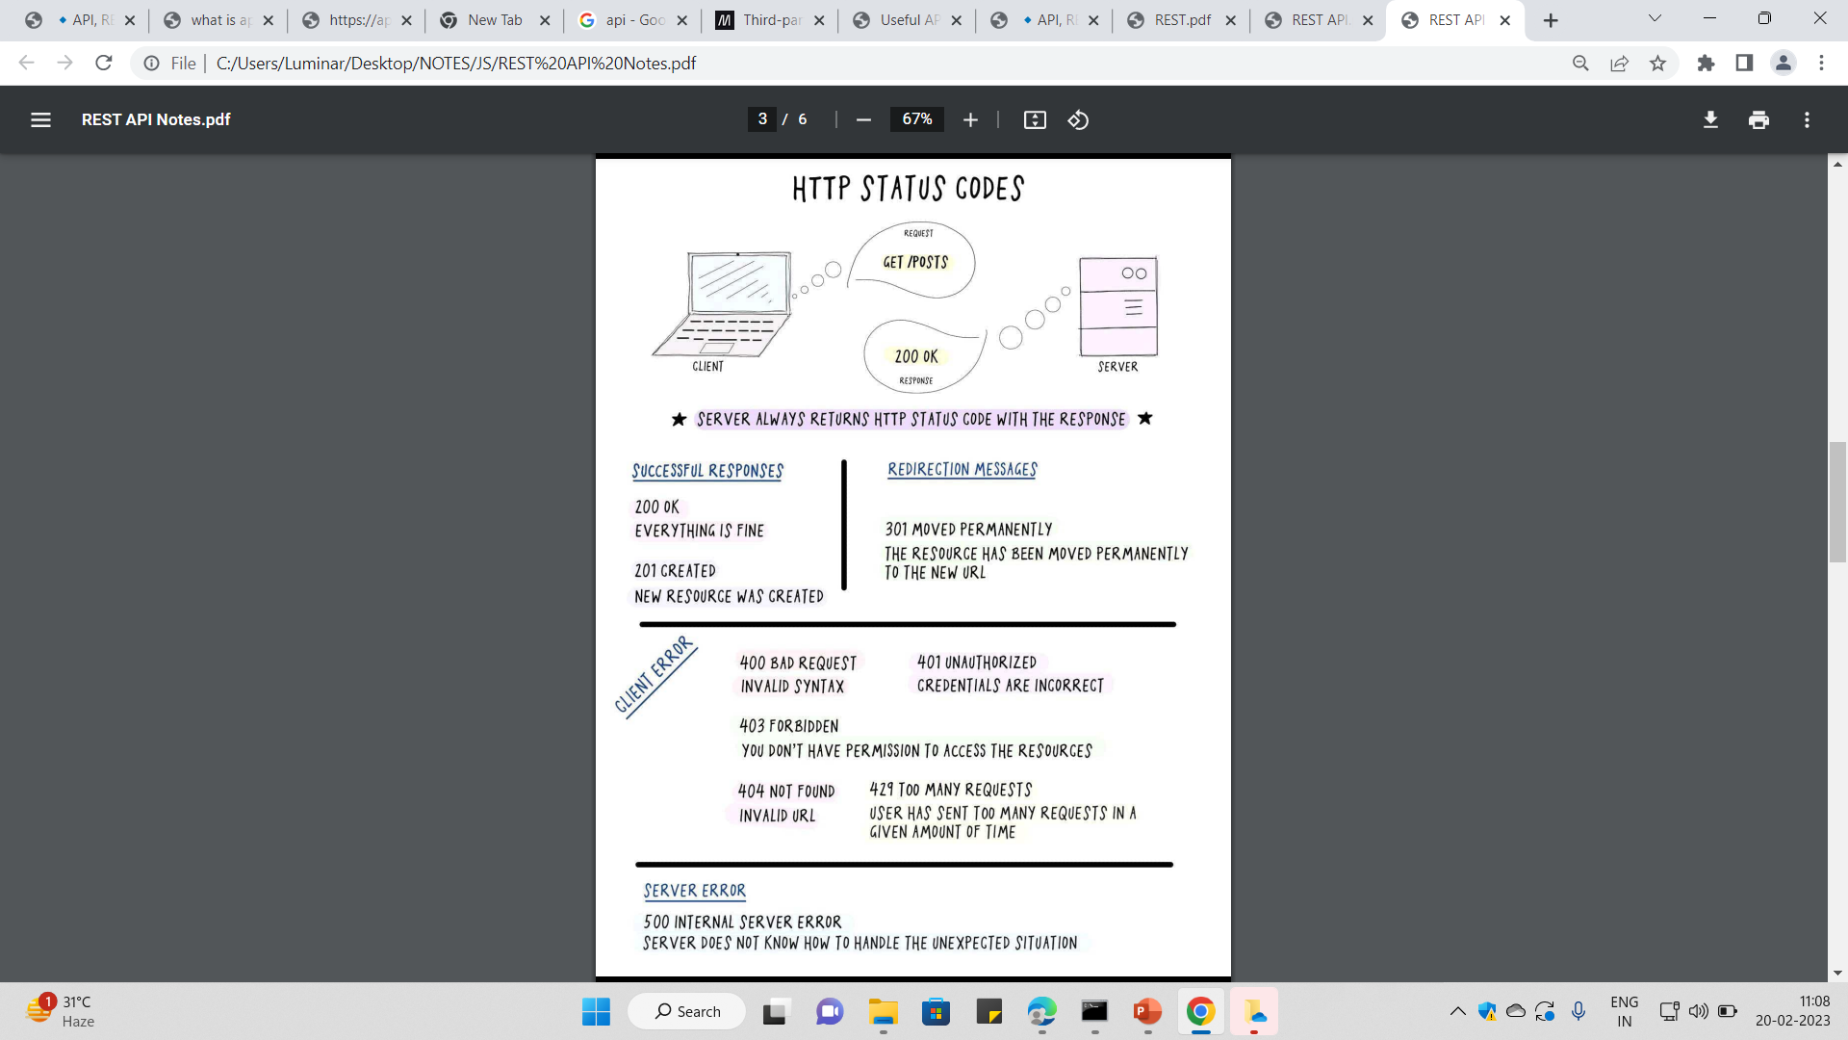

Slide 14
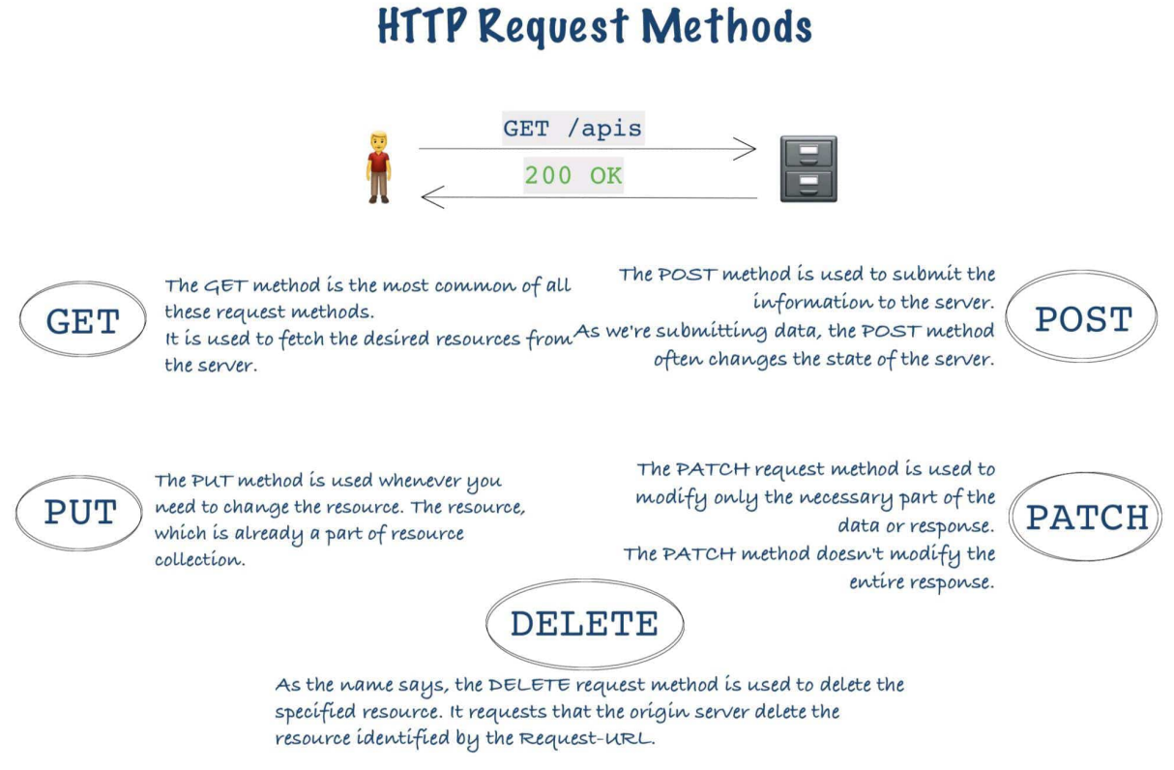

Slide 15
REST API and RESTful API
Difference between REST API and RESTful API
Find a Api

